Slide 1
Topic: Bivariate Data EQ: How do I compare bivariate Data?

Slide 2
Contents
Glossary or Formula Page
Page
Date
Description
2
3

Slide 3
Tasks
24
7
30
Essential Question
Questions
Notes
Summary
4
5

Slide 4
24
7
30
Date
Bivariate Data
EQ: How do I compare bivariate Data?
What is Bivariate data
Bivariate data is data represented by two variables.
What is the relationship between the two variables?
1. Are the values of one variable related to the values of another variable?
2. Can the values of one variable be used to predict the values of another variable?
5

Slide 5
24
7
30
Date
Bivariate Data
EQ: How do I compare bivariate Data?
What is Bivariate data
5

Slide 6
24
7
30
Date
Bivariate Data
EQ: How do I compare bivariate Data?
What is Bivariate data
Bivariate data is data represented by two variables.
5

Slide 7
24
7
30
Date
Bivariate Data
EQ: How do I compare bivariate Data?
What is Bivariate data
Bivariate data is data represented by two variables.
What is the relationship between the two variables?
5

Slide 8
24
7
30
Date
Bivariate Data
EQ: How do I compare bivariate Data?
What is Bivariate data
Bivariate data is data represented by two variables.
What is the relationship between the two variables?
1. Are the values of one variable related to the values of another variable?
5

Slide 9
24
7
30
Date
Bivariate Data
EQ: How do I compare bivariate Data?
What is Bivariate data
Bivariate data is data represented by two variables.
What is the relationship between the two variables?
1. Are the values of one variable related to the values of another variable?
2. Can the values of one variable be used to predict the values of another variable?
5

Slide 10
24
7
30
Date
Bivariate Data
EQ: How do I compare bivariate Data?
This is an example of bivariate data. The two variables are Year and $Abillion.
Value of Australian exports to China
Year | $Abillion
2006 | 20
2007 | 25
2008 | 30
2009 | 45
2010 | 60
2011 | 75
5

Slide 11
24
7
30
Date
Bivariate Data
EQ: How do I compare bivariate Data?
This is an example of bivariate data. The two variables are Year and $Abillion.
Value of Australian exports to China
Year | $Abillion
2006 | 20
2007 | 25
2008 | 30
2009 | 45
2010 | 60
2011 | 75
Is there a relationship between Year and the value of exports to China?
5

Slide 12
24
7
30
Date
Bivariate Data
EQ: How do I compare bivariate Data?
This is an example of bivariate data. The two variables are Year and $Abillion.
Value of Australian exports to China
Year | $Abillion
2006 | 20
2007 | 25
2008 | 30
2009 | 45
2010 | 60
2011 | 75
Is there a relationship between Year and the value of exports to China?
Can a prediction be made about the value of exports to China in 2012?
5

Slide 13
In summary
We often want to know if there is a relationship between the items in two different data sets. Examples of this are:
Is there a relationship between children’s ages and their heights?
Is there a relationship between people’s heights and weights?
Is there a relationship between students’ marks in an English examination and their marks in a mathematics examination?
In each of the above, two pieces of information are to be collected from each person in the investigation and then the two data sets are to be compared. When two pieces of information are collected from each subject in an investigation, we are then concerned with bivariate data.

Slide 14
24
7
30
Date
Bivariate Data
EQ: How do I compare bivariate Data?
What is a Scatterplot?
5

Slide 15
24
7
30
Date
Bivariate Data
EQ: How do I compare bivariate Data?
What is a Scatterplot?
Scatterplots give a visual representation of how the values of one variable are related to the values of another variable.
5

Slide 16
24
7
30
Date
Bivariate Data
EQ: How do I compare bivariate Data?
What is a Scatterplot?
Scatterplots give a visual representation of how the values of one variable are related to the values of another variable.
Value of Australian exports to China
Year | $Abillion
2006 | 20
2007 | 25
2008 | 30
2009 | 45
2010 | 60
2011 | 75
5

Slide 17
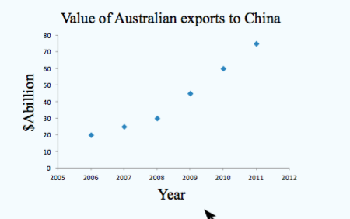
24
7
30
Date
Bivariate Data
EQ: How do I compare bivariate Data?
What is a Scatterplot?
Scatterplots give a visual representation of how the values of one variable are related to the values of another variable.
Value of Australian exports to China
Year | $Abillion
2006 | 20
2007 | 25
2008 | 30
2009 | 45
2010 | 60
2011 | 75
5

Slide 18
24
7
30
Date
Bivariate Data
EQ: How do I compare bivariate Data?
What is a Scatterplot?
Scatterplots give a visual representation of how the values of one variable are related to the values of another variable.
Value of Australian exports to China
Year | $Abillion
2006 | 20
2007 | 25
2008 | 30
2009 | 45
2010 | 60
2011 | 75
The independent variable, Year, is placed on the x-axis.
The dependent ($) , Year, is placed on the y-axis.
5

Slide 19
24
7
30
Date
Bivariate Data
EQ: How do I compare bivariate Data?
Value of Australian imports from China
Year | $Abillion
2006 | 25
2007 | 30
2008 | 35
2009 | 35
2010 | 35
2011 | 40
5

Slide 20
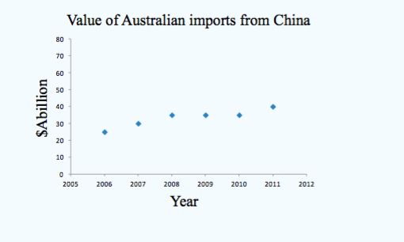
24
7
30
Date
Bivariate Data
EQ: How do I compare bivariate Data?
Value of Australian imports from China
Year | $Abillion
2006 | 25
2007 | 30
2008 | 35
2009 | 35
2010 | 35
2011 | 40
5

Slide 21
24
7
30
Date
Bivariate Data
EQ: How do I compare bivariate Data?
Value of Australian imports from China
Year | $Abillion
2006 | 25
2007 | 30
2008 | 35
2009 | 35
2010 | 35
2011 | 40
$Abillion depends on the Year, thus $Abillion is the dependent variable. Year is the independent variable.
5

Slide 23
In Summary
A scatter graph or scatter plot is a type of display that uses coordinates to display values for two variables for a set of data. The data is displayed as a collection of points, each having the value of one variable determining the position of the horizontal coordinate and the value of the other variable determining the position of the vertical coordinate.

Slide 24
Notes Review
24, 7 ,30
Date
Title
Essential question
Notes complete
Notes complete with colour and diagrams
Questions completed
Contents page filed in
Formula page filled in

Slide 25
Homework
Review your notes and write a summary answering the essential question.

